Slide 1


Machine Learning
Al-Imam Mohammad ibn Saud Islamic University
College of Computer and Information Sciences
Computer Science Department
CS 364: Machine Learning
1st Semester 1445
CS383

Slide 2
الرقم الاكاديمي | الطالب
441013628 | Meshari Abdulrahman Almouslfeh
441013300 | Faisal Abdullah bin awn
441017066 | Abdulkarim Hassan Alharthi
Instructor: Qaisar Abbas Muhammad Abbas.

Slide 3


Title and Authors
"Improving City Traffic Predictions with Machine Learning"

Slide 4
Introduction:
Urban Challenges:
Explore the impact of rapid urbanization and technological advancements on city living.
Smart City Concept:
Understand how technology and data-driven solutions enhance urban living.
Traffic Management Importance:
Recognize the critical role of traffic management in creating sustainable and efficient cities.

Slide 5
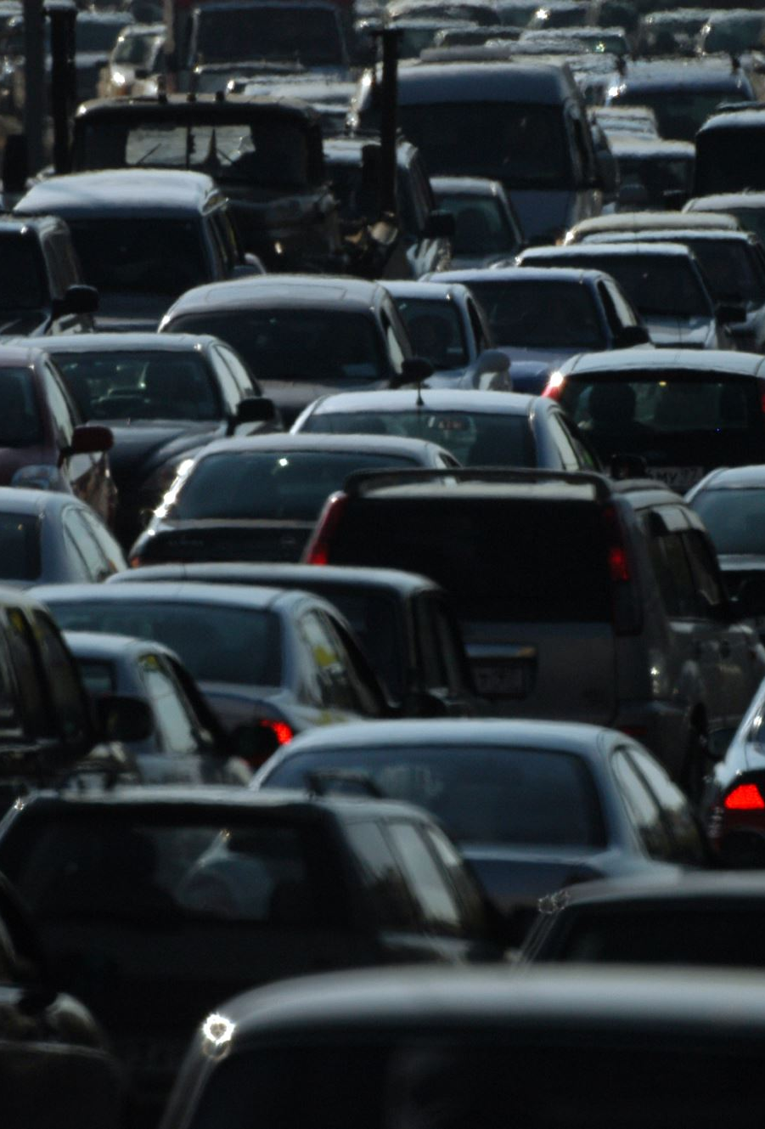
Project Overview
Problem Statement:Dive into the challenge of addressing traffic congestion through predictive modeling.

Slide 6
Dataset Description
Selected Dataset:
Discover the comprehensive time series dataset capturing traffic volume at different junctions.
Attributes/Features Types:
Explore the features, including Date Time, Junction, Vehicles, and ID, with detailed explanations.
Target Concept Visualization:
Visualize traffic patterns and variations through a graphical representation.

Slide 7
Machine Learning Model Selection
Selected ML Model:
Introduce the Decision Tree Regressor and understand why it's chosen for the task.
Rationale:
Grasp the versatility of Decision Tree Regressor for regression tasks, its interpretability, and ability to handle complex relationships.

Slide 8
Implementation
Technical Framework:
Simplify the technical framework, highlighting the use of Python, pandas, and sklearn.
Step-by-Step Process:
Break down the implementation process, from loading data to model training and testing.

Slide 9

Evaluation & Results Discussion
Model Performance Analysis:
Learn how the Decision Tree Regressor performs against unseen test data.
Metrics Used:
Understand the metrics, RMSE and R-squared, used for model evaluation.

Slide 10
Model Comparison
Visual Representation:
Visualize a comparison between Decision Tree Regressor and other potential models.
Pros and Cons:
Simplify the strengths and limitations of the chosen model.

Slide 11
Technical Framework
Detailed Process:
Break down the technical process, providing a step-by-step explanation.
Code Snippet:
Include a simplified Python code snippet showcasing the technical implementation.

Slide 12
Conclusion
Key Findings/Contributions:
Summarize the key learnings, emphasizing the successful application of machine learning in predicting traffic volume.
Summary:
Provide a quick, digestible overview of the project's impact on smart city planning.

Slide 13
Thank you for your listening

